Slide 1
User Engagement and Transaction Analysis
Presented By
Olaewe Olufunmilola Olapeju

Slide 2
Table Of Content
01OBJECTIVES
02
PROBLEM STATEMENT
03 DASHBOARD
04 INSIGHTS
05 CONCLUSIONS & RECOMMENDATIONS

Slide 3
PROBLEM STATEMENT & OVERALL GOALS
This analysis aims to provide insights for data-driven decision-making by focusing on:
The need to better understand customer behavior, KYC process, transaction trends, and user retention to drive growth and improve operations.
And the overall goals is to use data to monitor growth, optimize the KYC journey, analyze transaction performance, and identify drop-offs in the user funnel.

Slide 4
OBJECTIVES
The Objective focus is to drive business Growth:
By Tracking user growth and profile demographics; Evaluating (Know Your Status) KYC distribution; the measure of transaction volume (in CAD); and identifying active users along with key drop-off points in the user journey.

Slide 5
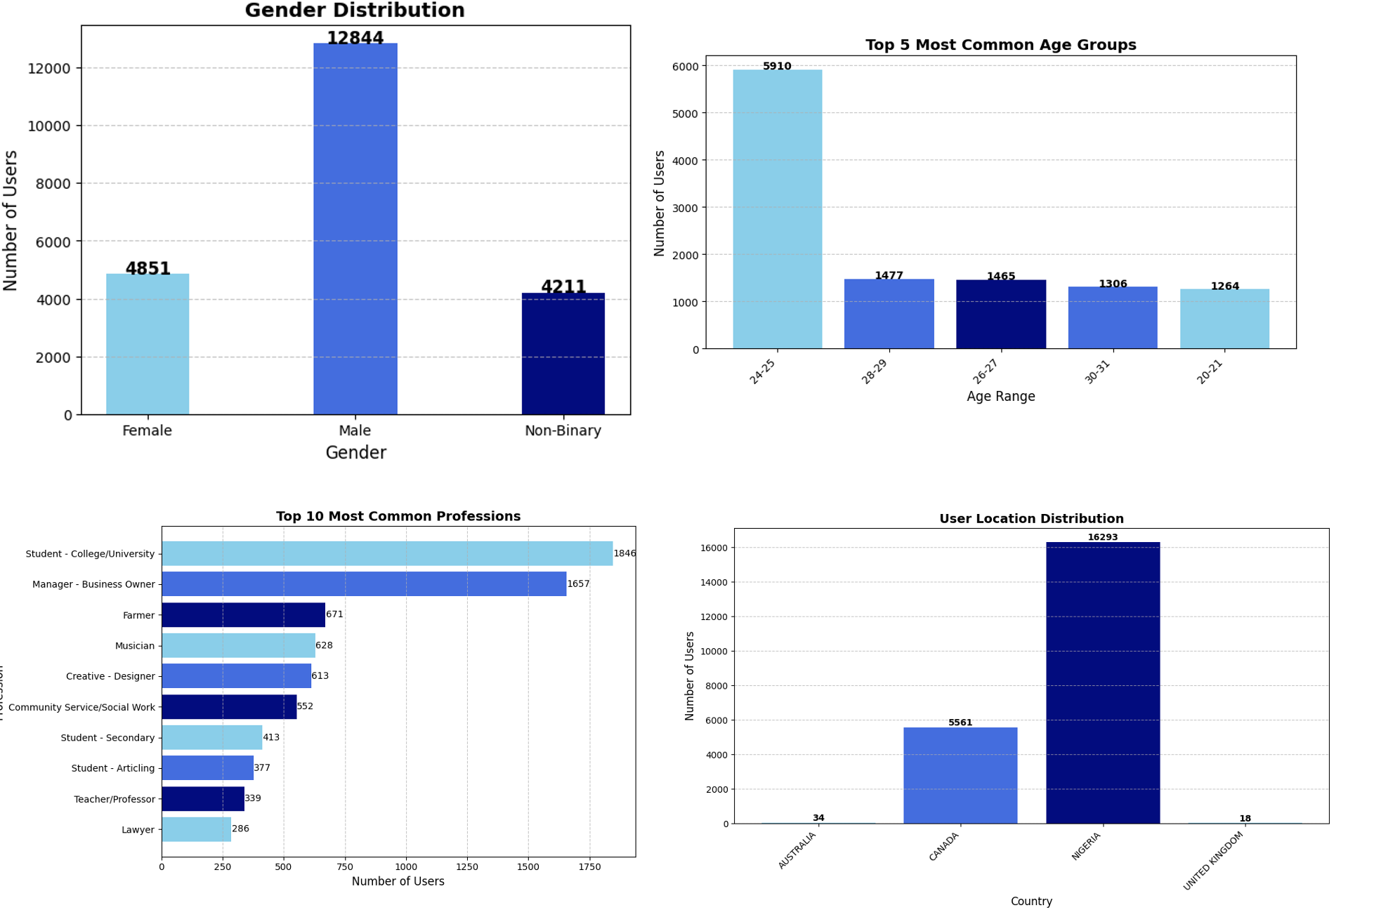
INSIGHTS FROM USER ANALYSIS

Slide 6
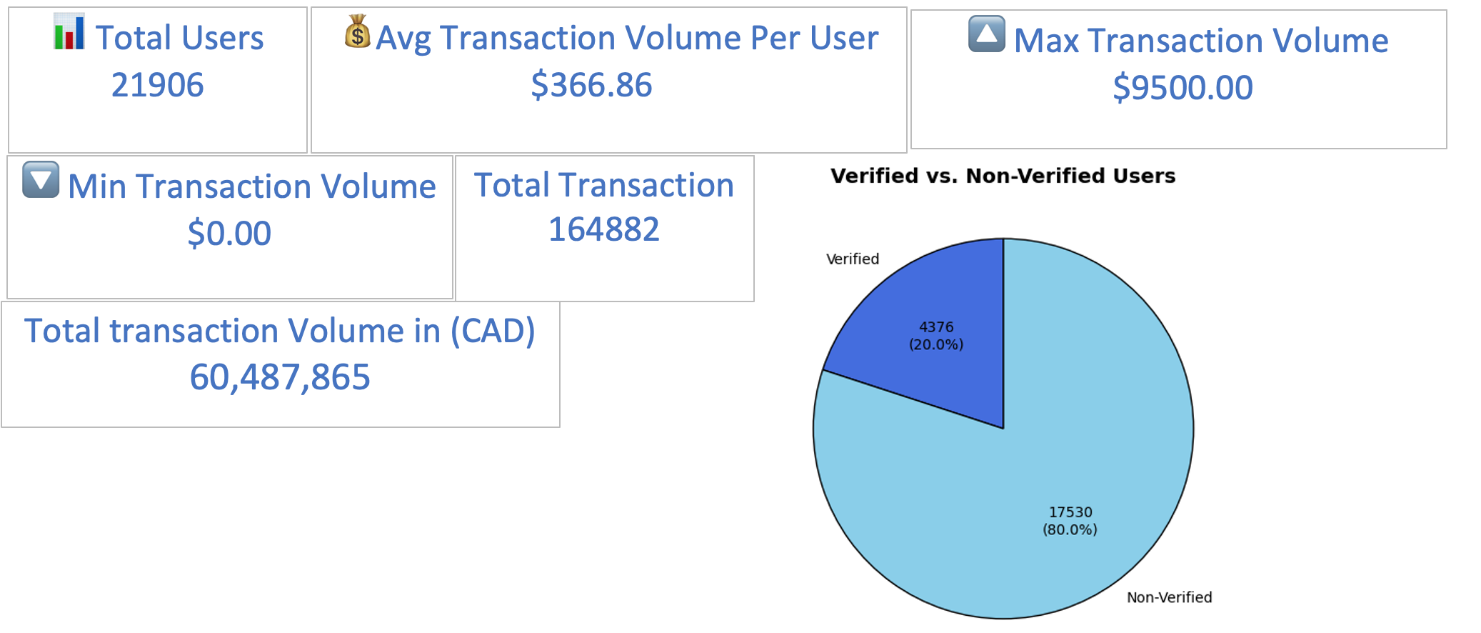
INSIGHTS FROM USER ANALYSIS

Slide 7
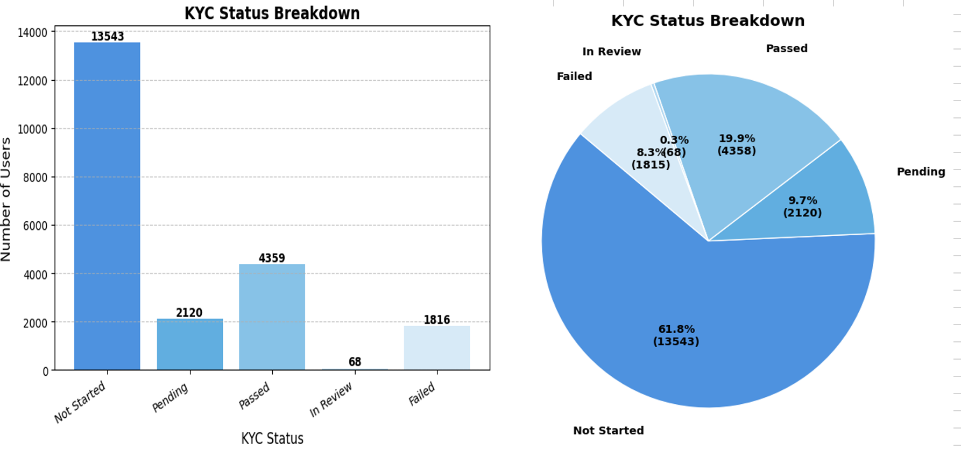
INSIGHTS FROM KYC STATUS

Slide 8
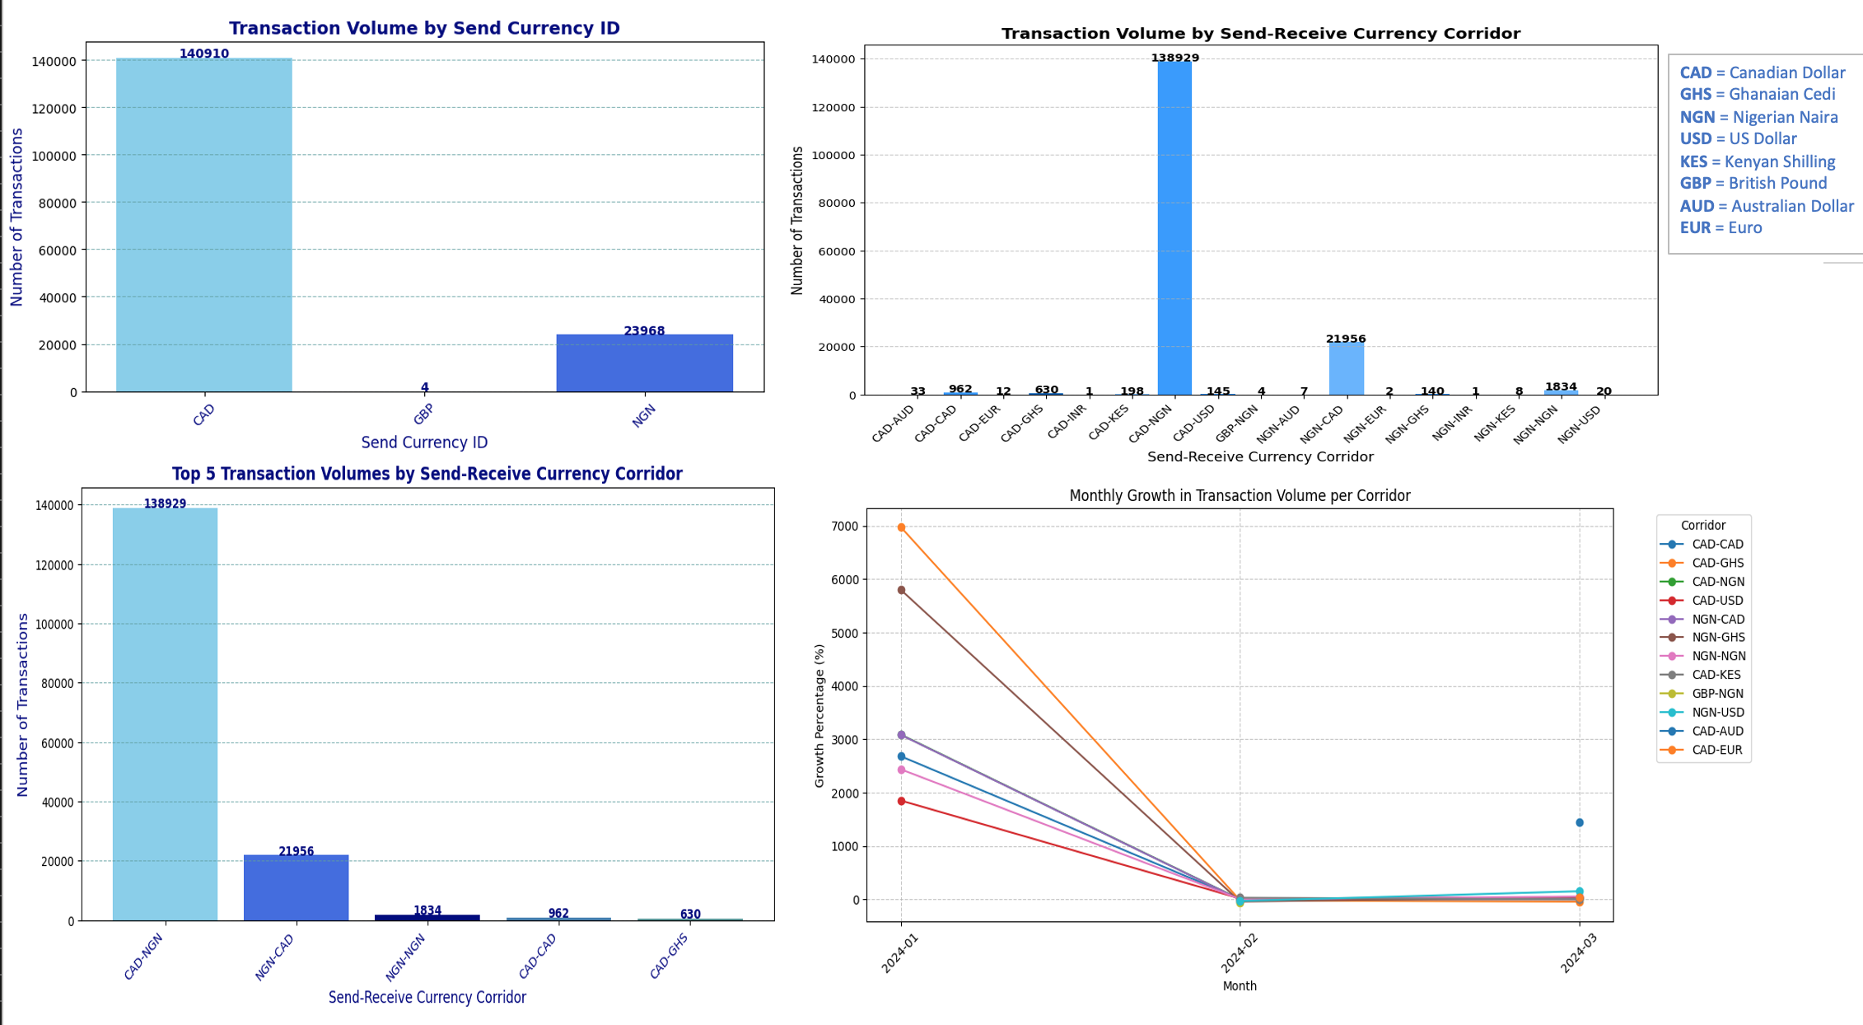
INSIGHTS FROM TRANSACTION ANALYSIS

Slide 9
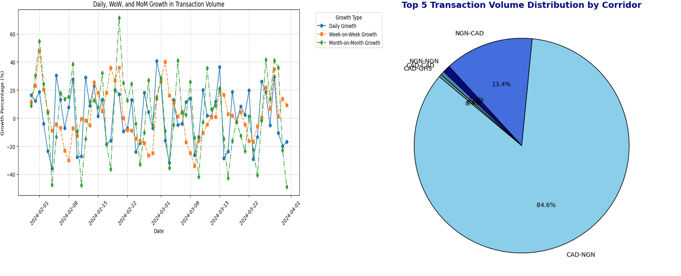
INSIGHTS FROM TRANSACTION ANALYSIS

Slide 10
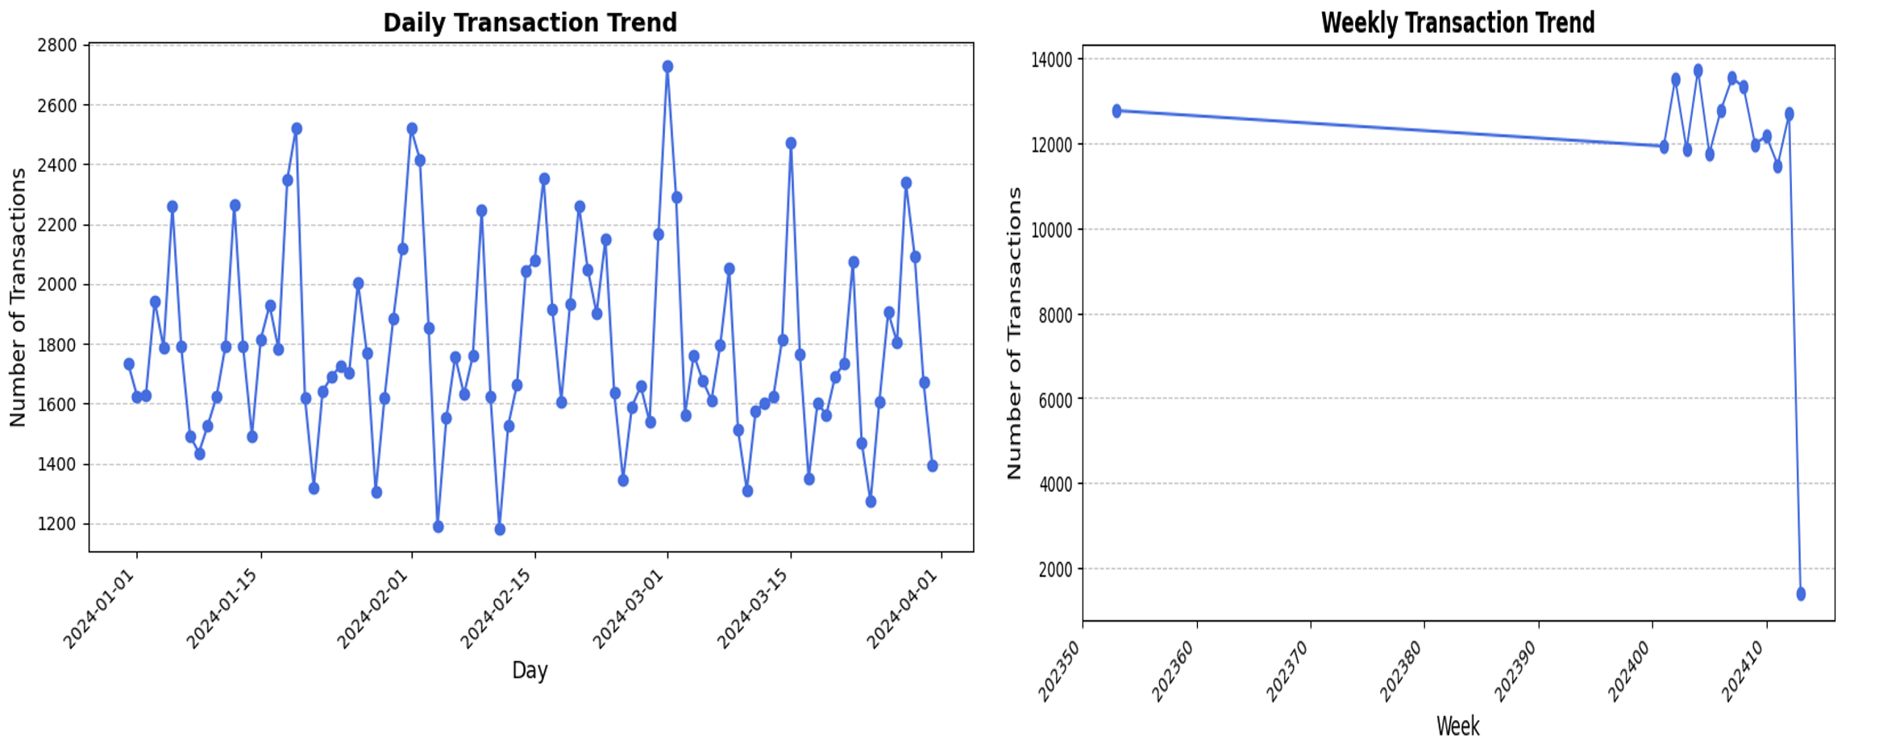
INSIGHTS FROM CUSTOMER RETENTION ANALYSIS

Slide 11
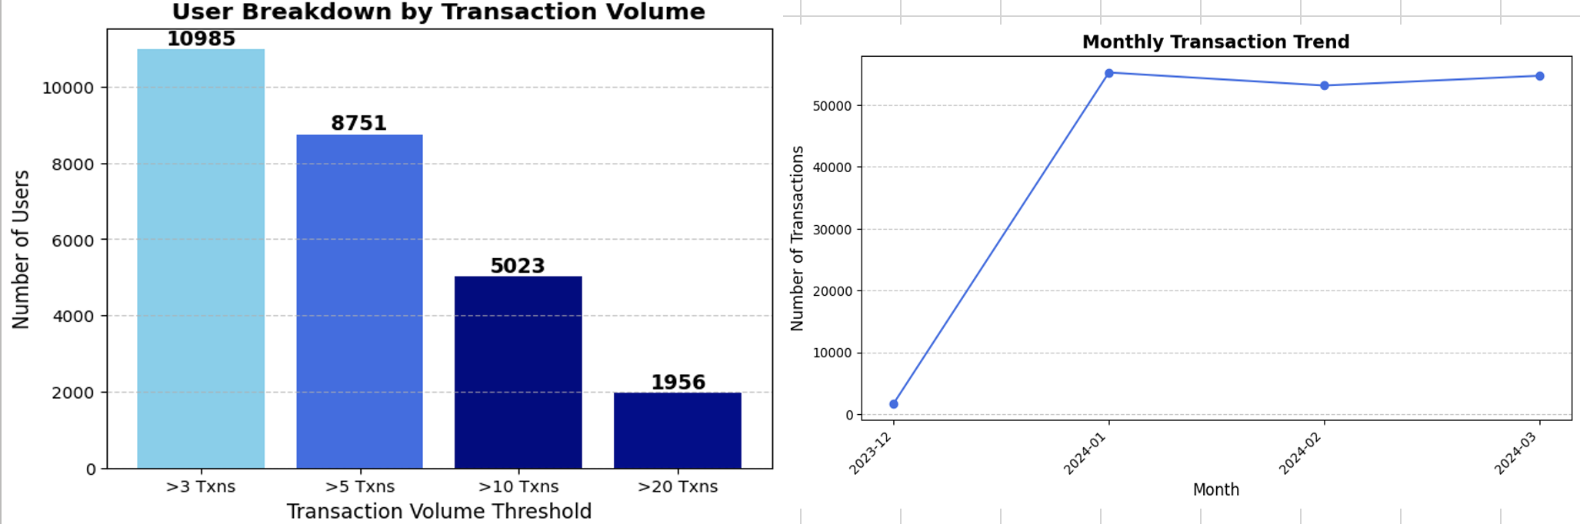
INSIGHTS FROM CUSTOMER RETENTION ANALYSIS

Slide 12
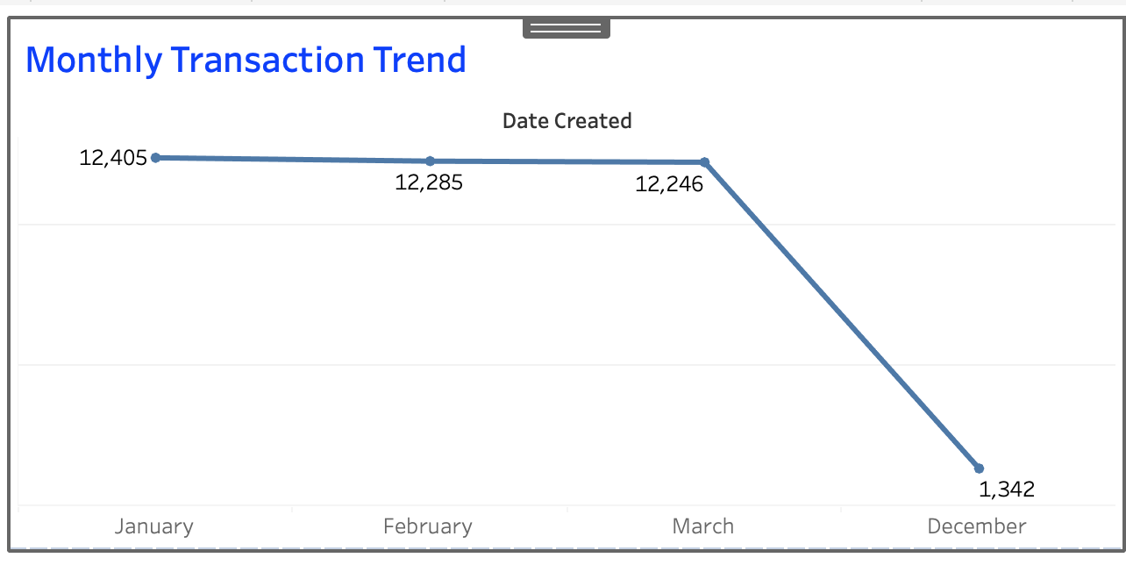
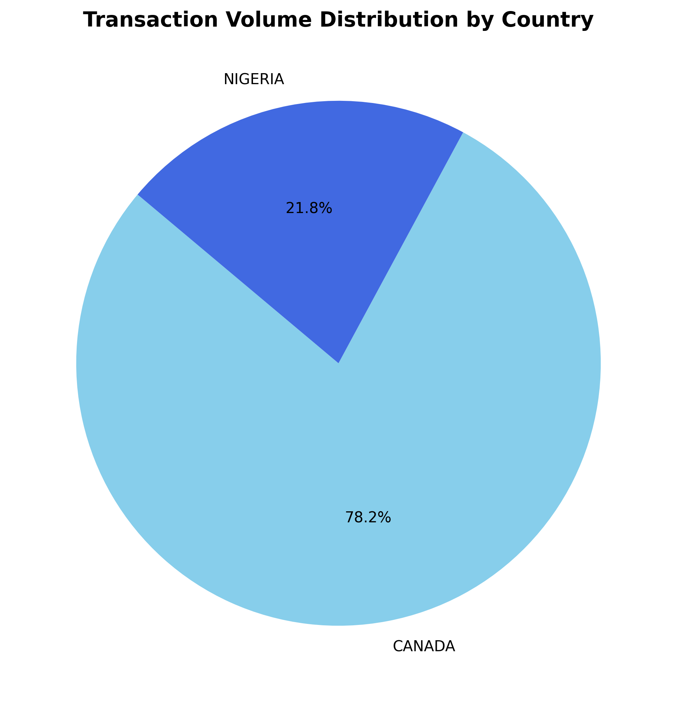
INSIGHTS FROM CUSTOMER RETENTION ANALYSIS

Slide 13
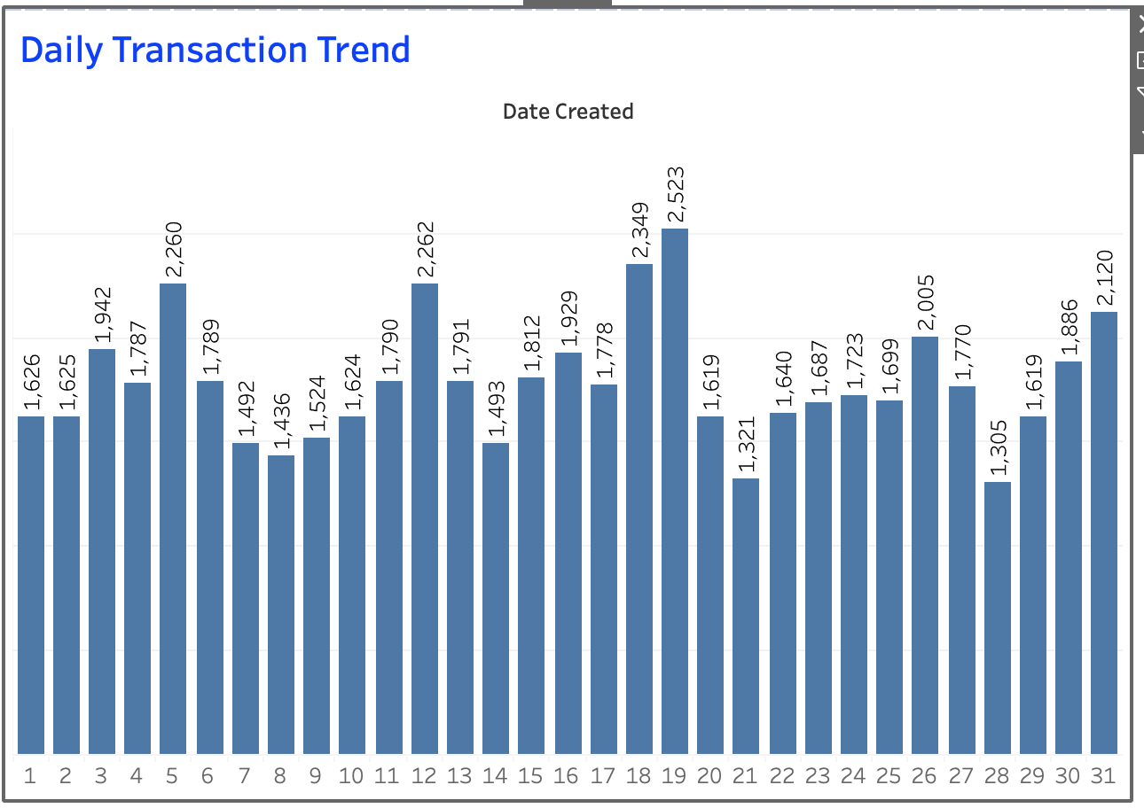
INSIGHTS FROM CUSTOMER RETENTION ANALYSIS

Slide 14
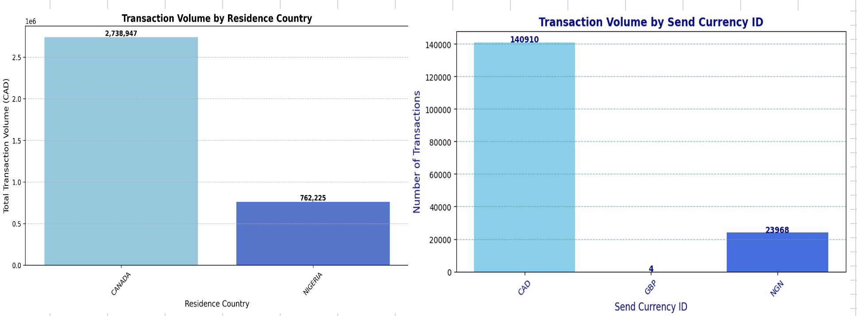
INSIGHTS FROM CUSTOMER RETENTION ANALYSIS
Notes:
SELECT * FROM ⁠ transactions ⁠ WHERE UserID NOT IN (SELECT UserID FROM ⁠ users ⁠) 158096

Slide 15
INSIGHTS FROM CUSTOMER RETENTION ANALYSIS
NOTE Since the success of a transaction isn’t contingent on having a UserID, I have included all transaction rows in the analysis—even those with missing UserIDs—to ensure we capture the full volume of successful transactions. There are 60 UserID column on the Transaction Table

Slide 16
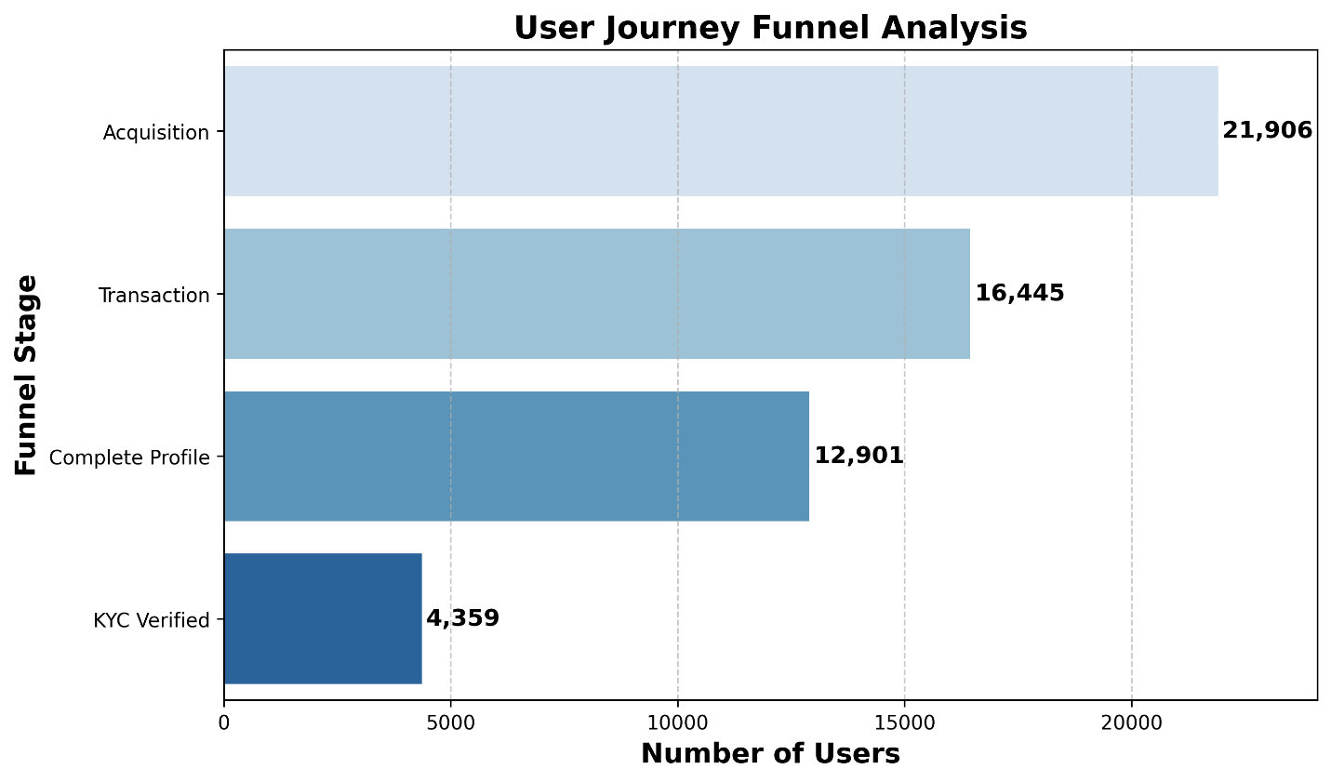
INSIGHTS FROM FUNNEL ANALYSIS

Slide 17
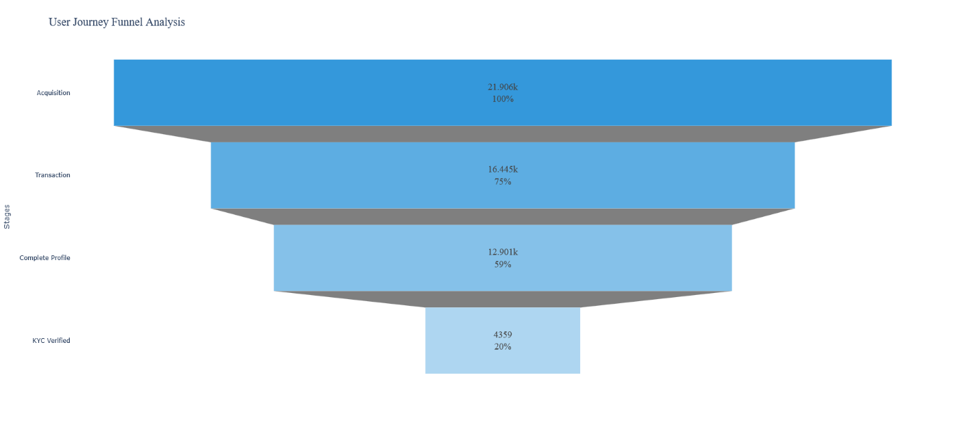
INSIGHTS FROM FUNNEL ANALYSIS

Slide 18
CONCLUSION
Where is the largest drop-off in the funnel? The biggest drop occurs between Acquisition (21,906) and Complete Profile (12,901), indicating many new sign-ups do not finish their profiles.
What strategies can address this drop-off?
Simplify Profile Completion – Make required steps fewer and more intuitive.
Provide Clear Benefits – Highlight why completing a profile is valuable (e.g., faster transactions).
Automated Reminders – Send friendly follow-ups via email or in-app prompts to encourage users to complete their profiles.

Slide 19
RECOMMENDATIONS
📌Simplify Profile Completion: Reduce required steps and provide clear instructions to help users quickly finish their profiles.
📌 Highlight KYC Benefits: Emphasize the advantages (e.g., faster transactions, higher limits) to motivate users to verify their accounts.

Slide 20
RECOMMENDATIONS
📌 Automated Reminders and Incentives: Send follow-ups or small rewards to nudge users who haven’t completed their profiles or KYC.
📌 Promote First Transactions: Offer clear guides or promos to encourage verified users to transact, keeping them active in the funnel.

Slide 21
THANK YOU

